Slide 1
Narrative
Personal and story writing

Slide 2
Narrative Writing
A Narrative is a STORY.
Narrative ~ A fictional story you can make up all of the events.
Personal Narrative~ A TRUE story about an event that happened in your life.
Purpose:
A narrative text tells a story and provides details in the sequence the events occur.
There has to be a complication to increase the interest of the reader
The story must have a definite ending.
Notes:
Examples of narration Short stories Novels Biographies Fairy-tales FantasyDetective stories
Narrative writing Skills covered:
Reading Widely
Believable Characters
Cause and Effect
Effective Dialogue
Tension
Themes
Ending Well

Slide 3
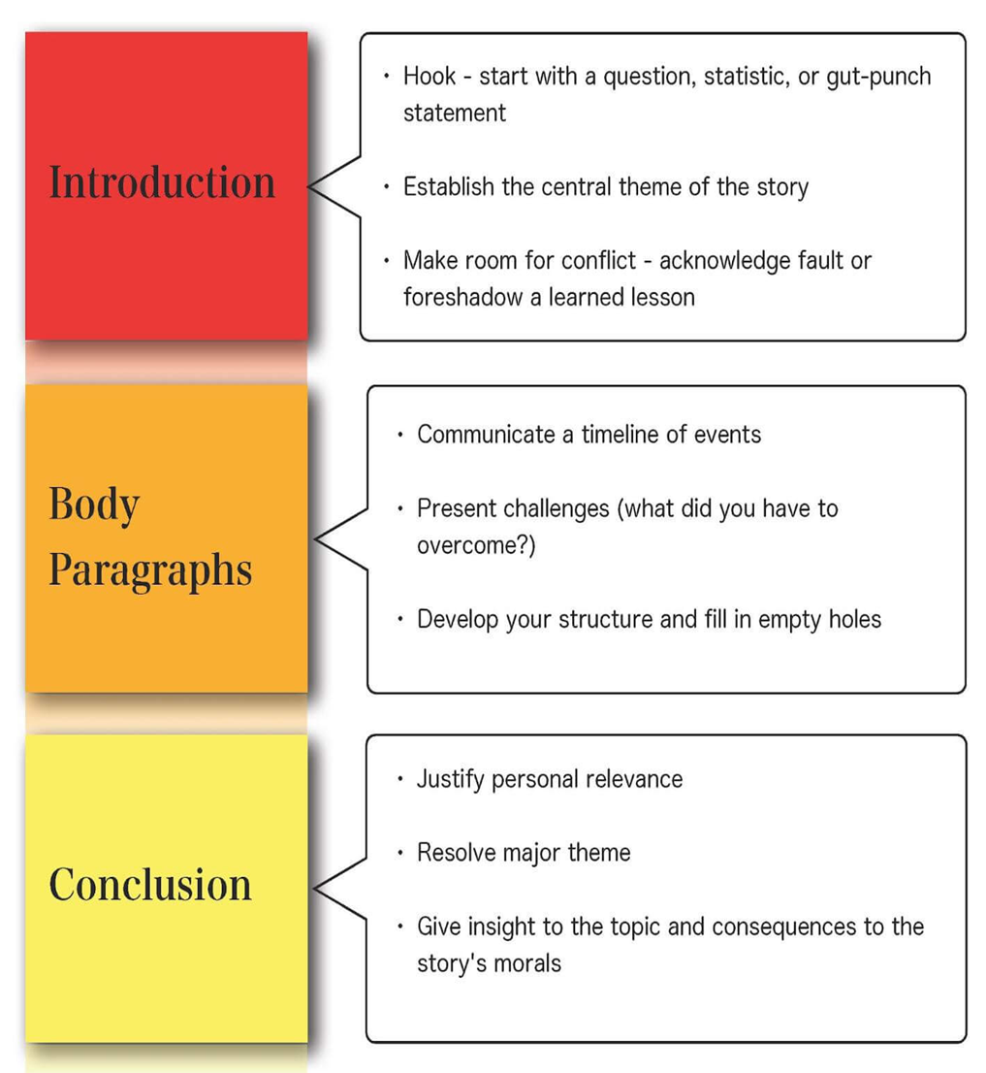
Order
Beginning:
Introduce characters, place (setting)
An orientation (introduction)that tells us about the who?, where? and when? of the story.
Middle: (main body)
sequence of events happening (Rising Action)
leads to a complication where some problem confronting the characters arises.
Use of details Keep the events progressing forward.
End:
resolution (conclusion)
Result (Falling Action )
where the crisis caused by the complication is solved. In short stories this is often at the very end of the story
Notes:
The text of a narrative is organized into: A good narrative: Involves readers in the story Tells events in sequence Includes detailed observations of people, places, and events
Presents important changes, contrasts, or conflicts and creates tension
Focuses on connection between past events, people, or places and the present

Slide 4
Narrative Writing
Tell a fictional story.
Write the events in order.
Remember your plot diagrams.
You can do flashbacks.
Paragraphs can be any size. INDENT!
Still proper grammar, spelling and capitalization.
Notes:
TIPS Always decide on your plot before you start writing! Always decide on your plot before you start writing!Sequence of events is very important. Use time words such as: at first, before, until, while, during, then, after, finally, etc.Use various adjectives (disgusting, terrified…) and adverbs (desperately, surprisingly, etc) to describe feelings and actionsUse linking words or phrases to join the ideas and make your story flow.
Use direct speech.Variety of verbs will make your story more fascinating to read.Be careful with the tenses you choose.Descriptions of people, places, objects or events and descriptive techniques can be used in a narrative when you want to emphasize specific parts of your narration.

Slide 5
Starting Stories: Beginning Strategies
Begin with action or dialogue.
I crouched in starting position, hands poised on the track and back coiled like a spring. "On your mark! Get set!" The starting gun boomed. I launched myself forward, trying to spring ahead of the pack.
Ask a question.
Why does trouble always follow me around? Do I have a "kick me" sign on my back or something?
Describe the setting.
I sat cradled in three branches at the top of an old oak behind my house. I could see over the rooftop, could see for miles. Overhead, planes lined up in the sky, heading toward O'Hare Airport to land one by one.
Begin with background information.
Taha my little brother, is in the first grade. He's fearless. One day, he wore a cape to school. I told him everyone would laugh at him. The next day, five other boys came wearing capes.
Have the main character introduce himself or herself.
I'm Talia. I just turned 13, and I'm here to tell you a secret.
Notes:
The beginning of a story sets the tone for everything that will happen next.

Slide 6
Use one of the following prompts to begin your narrative
The wind swirled around me and the world went black...
"Surprise!" They cried, leaping out from behind the door...
It’s a strange and scary sensation to suddenly forget your own name…
I have always hated chocolate, so I was more surprised than anybody to find myself standing outside of the quaint chocolate shop on the outskirts of town…
Have you ever had a feeling that something wasn’t right? That’s how I felt the day…
“What happened?” Dad asked, his mouth hanging open as he took in the state of the kitchen…
It was supposed to be a fun hike through the woods, but nobody could have imagined what it would become…

Slide 7

Ending Stories: Strategies
Ask a rhetorical question.
“But why are you invested in other people’s stories? You too must be unable to fill in the gaps. Can’t you be satisfied with your own dreams?” — Antonio Tabucchi, “A Riddle”
Description.
“Boom-splash. The pelicans take these kamikaze plunges into the water. The way they hit, not one should survive — but of course they all do. They come up with their beaks full of fish.” — Taylor Antrim, “Pilgrim Life”
Referring to your feelings or moods.
“She will see the garden that day and the tears shining in her sister’s large blue eyes and remember her unanswered cry for help.” — Sheila Kohler, “Magic Man”
Creating Mystery
“Your time’s not up. Your time’s not even close to being up.”— David Means, “The Chair “
“And even when the teacher turns me toward the classrooms and I hear what must be the singing and talking of all the children in the world, I can still hear my mother’s footsteps above it all.” — Edward P. Jones, “The First Day”
Notes:
The beginning of a story sets the tone for everything that will happen next.
describe a particular thing in the story which resonates with the main themes of your story. If you’re writing about father/son relationships, then end on the description of your character seeing a father walk with his son.

Slide 8
A man stands under a tree. He is pacing up and down nervously. He glances at his watch every few seconds.
student One asks the question, “And then what?”
Student two : answers by describing what happens next.
Student three:, “And then what?”.
repeat until you have worked through the
problem,
rising action
Climax
falling action
and resolution.

Slide 9
Beginning
Ending
Ordinary
I woke up and got out of bed. I had a shower, ate breakfast and left.
interesting
Bright morning sunlight was shining through my bedroom window when I woke. I lay there lazily for a few minutes, then jumped out of bed…
Simple ending
At last I was home again, and soon went to bed. It had been a tiring day.
Interesting ending
Exhausted and soaked to the skin, I slammed the front door behind me. I threw myself onto my bed, stared into the darkness and thought bitterly, “why me?”
Notes:
This is called the EXPOSITION. It is the background information on the characters and setting explained at the beginning of the story.
The EXPOSITION will often have information about events that happened before the story began. The EXPOSITION is often the very first part of the PLOT.

Slide 10
EXPRESSIONS /PHRASES
It was too good to be true It was a real shock I couldn’t believe my eyes/luck
It was getting on my nerves
I was in luck / out of luck
It was the best/worst ever
Unluckily / luckily I was in good/ bad mood
I breathed a sigh of relief
I was left speechless
I was out of relief
All of a sudden / suddenly
My heart was beating furiously
The next thing I knew
It made me jump
To my surprise
I burst out laughing / into tears
Without a doubt / Beyond any doubt

Slide 11
Narrative Vocabulary
Hyperbole: I am so hungry I could eat a horse. I am so tired I could die.
Alliteration: Billy Bob bought a bright blue BMW.
Point of View
First Person: Character is the narrator. Use “I” and “we”
Second Person: When the narrator puts the reader in place of the main character. Uses “you”
Third Person Limited: Only see the perspective of one character.
Third Person Omniscient:
The narrator knows the thoughts of all characters. You see the story from many perspectives.
Cause and effect: Do something, something happens
Chronological order: Events go in order of TIME
Flashback: Go back in time to explain an event or feeling
Foreshadowing: Hints to future events
Adjectives: Describe nouns
Sensory language: See, hear, feel, taste, smell
Figurative Language
Idiom: Piece of cake
Personification: The wind was screaming…
Oxymoron: Jumbo shrimp
Simile: She was like a tiger on the court.
Metaphor: She was a tiger…

Slide 12
Examples of Narrative Essays
“Goodbye to All That” by Joan Didion “I was in love with New York. I do not mean ‘love’ in any colloquial way, I mean that I was in love with the city, the way you love the first person who ever touches you and never love anyone quite that way again.”
“Self-Reliance” by Ralph Waldo Emerson “My life is not an apology, but a life. It is for itself and not for a spectacle. I much prefer that it should be of a lower strain, so it be genuine and equal, than that it should be glittering and unsteady.”
“Notes of a Native Son” by James Baldwin “Harlem, physically at least, has changed very little in my parents’ lifetime or in mine. Now as then the buildings are old and in desperate need of repair, the streets are crowded and dirty, there are too many human beings per square block.”
“My Life as an Heiress” by Nora Ephron “I never knew why my mother wasn’t close to her brother, Hal. I can guess. It’s possible that he didn’t help out financially with their parents. It’s possible that she didn’t like his wife, Eleanor. It’s possible that she resented forever the fact that her parents had found the money to send him to Columbia but made her go to a public college. Who knows? The secret is dead and buried.”
“Joy” by Zadie Smith“Perhaps the first thing to say is that I experience at least a little pleasure every day. I wonder if this is more than the usual amount? It was the same even in childhood when most people are miserable. I don’t think this is because so many wonderful things happen to me but rather that the small things go a long way.”
Notes:
“Goodbye to All That” by Joan Didion
Included in Slouching Towards Bethlehem, a collection of Didion’s essays, this piece delves into the emotions evoked by Didion’s leaving New York City, and her journey of self-awareness.
“Self-Reliance” by Ralph Waldo Emerson
American essayist Ralph Waldo Emerson was known for his exceptional personal narratives, delivered in both written and spoken form. His work is one of the best narrative essay examples of the 19th century.
“Notes of a Native Son” by James Baldwin
Reflecting on his life as a Black man in early– to mid–twentieth century America, James Baldwin’s narrative essays are frequently referenced to this day.
“My Life as an Heiress” by Nora Ephron
She may be known for her romantic comedy screenplays like You’ve Got Mail and When Harry Met Sally, but Nora Ephron began her career as a writer and found widespread success with her personal essays.
“Joy” by Zadie Smith
British essayist Zadie Smith has won numerous awards for her work and is a global best-selling novelist.

Slide 13
Group work
Organize students into groups
assign each group a well-known story. Traditional tales, myths, fairy tales, and fables would serve well for this activity.
In their groups, students rewrite their story’s ending together.
The challenge here is to create an ending that differs distinctly from the story’s original ending but still makes sense in relation to the preceding events of the story.
Students present their alternative endings to the class and discuss afterward how effective they think the new ending is when compared to the original ending.

Slide 14
Narrative topics
If you could only keep one memory of your family, what would it be and why?
When you go outside, which of your senses are you most thankful to have?
Describe your relationship with your parents
Write about the difference between how things seem and how they really are.
What are your secret survival strategies?

Slide 16
Quiz 1
Write an introductory paragraph for an expository essay on:
“The disadvantages of rigging in General Elections 2024 in Pakistan”.
Use Startling facts and figures as a reader’s hook.

